Slide 1



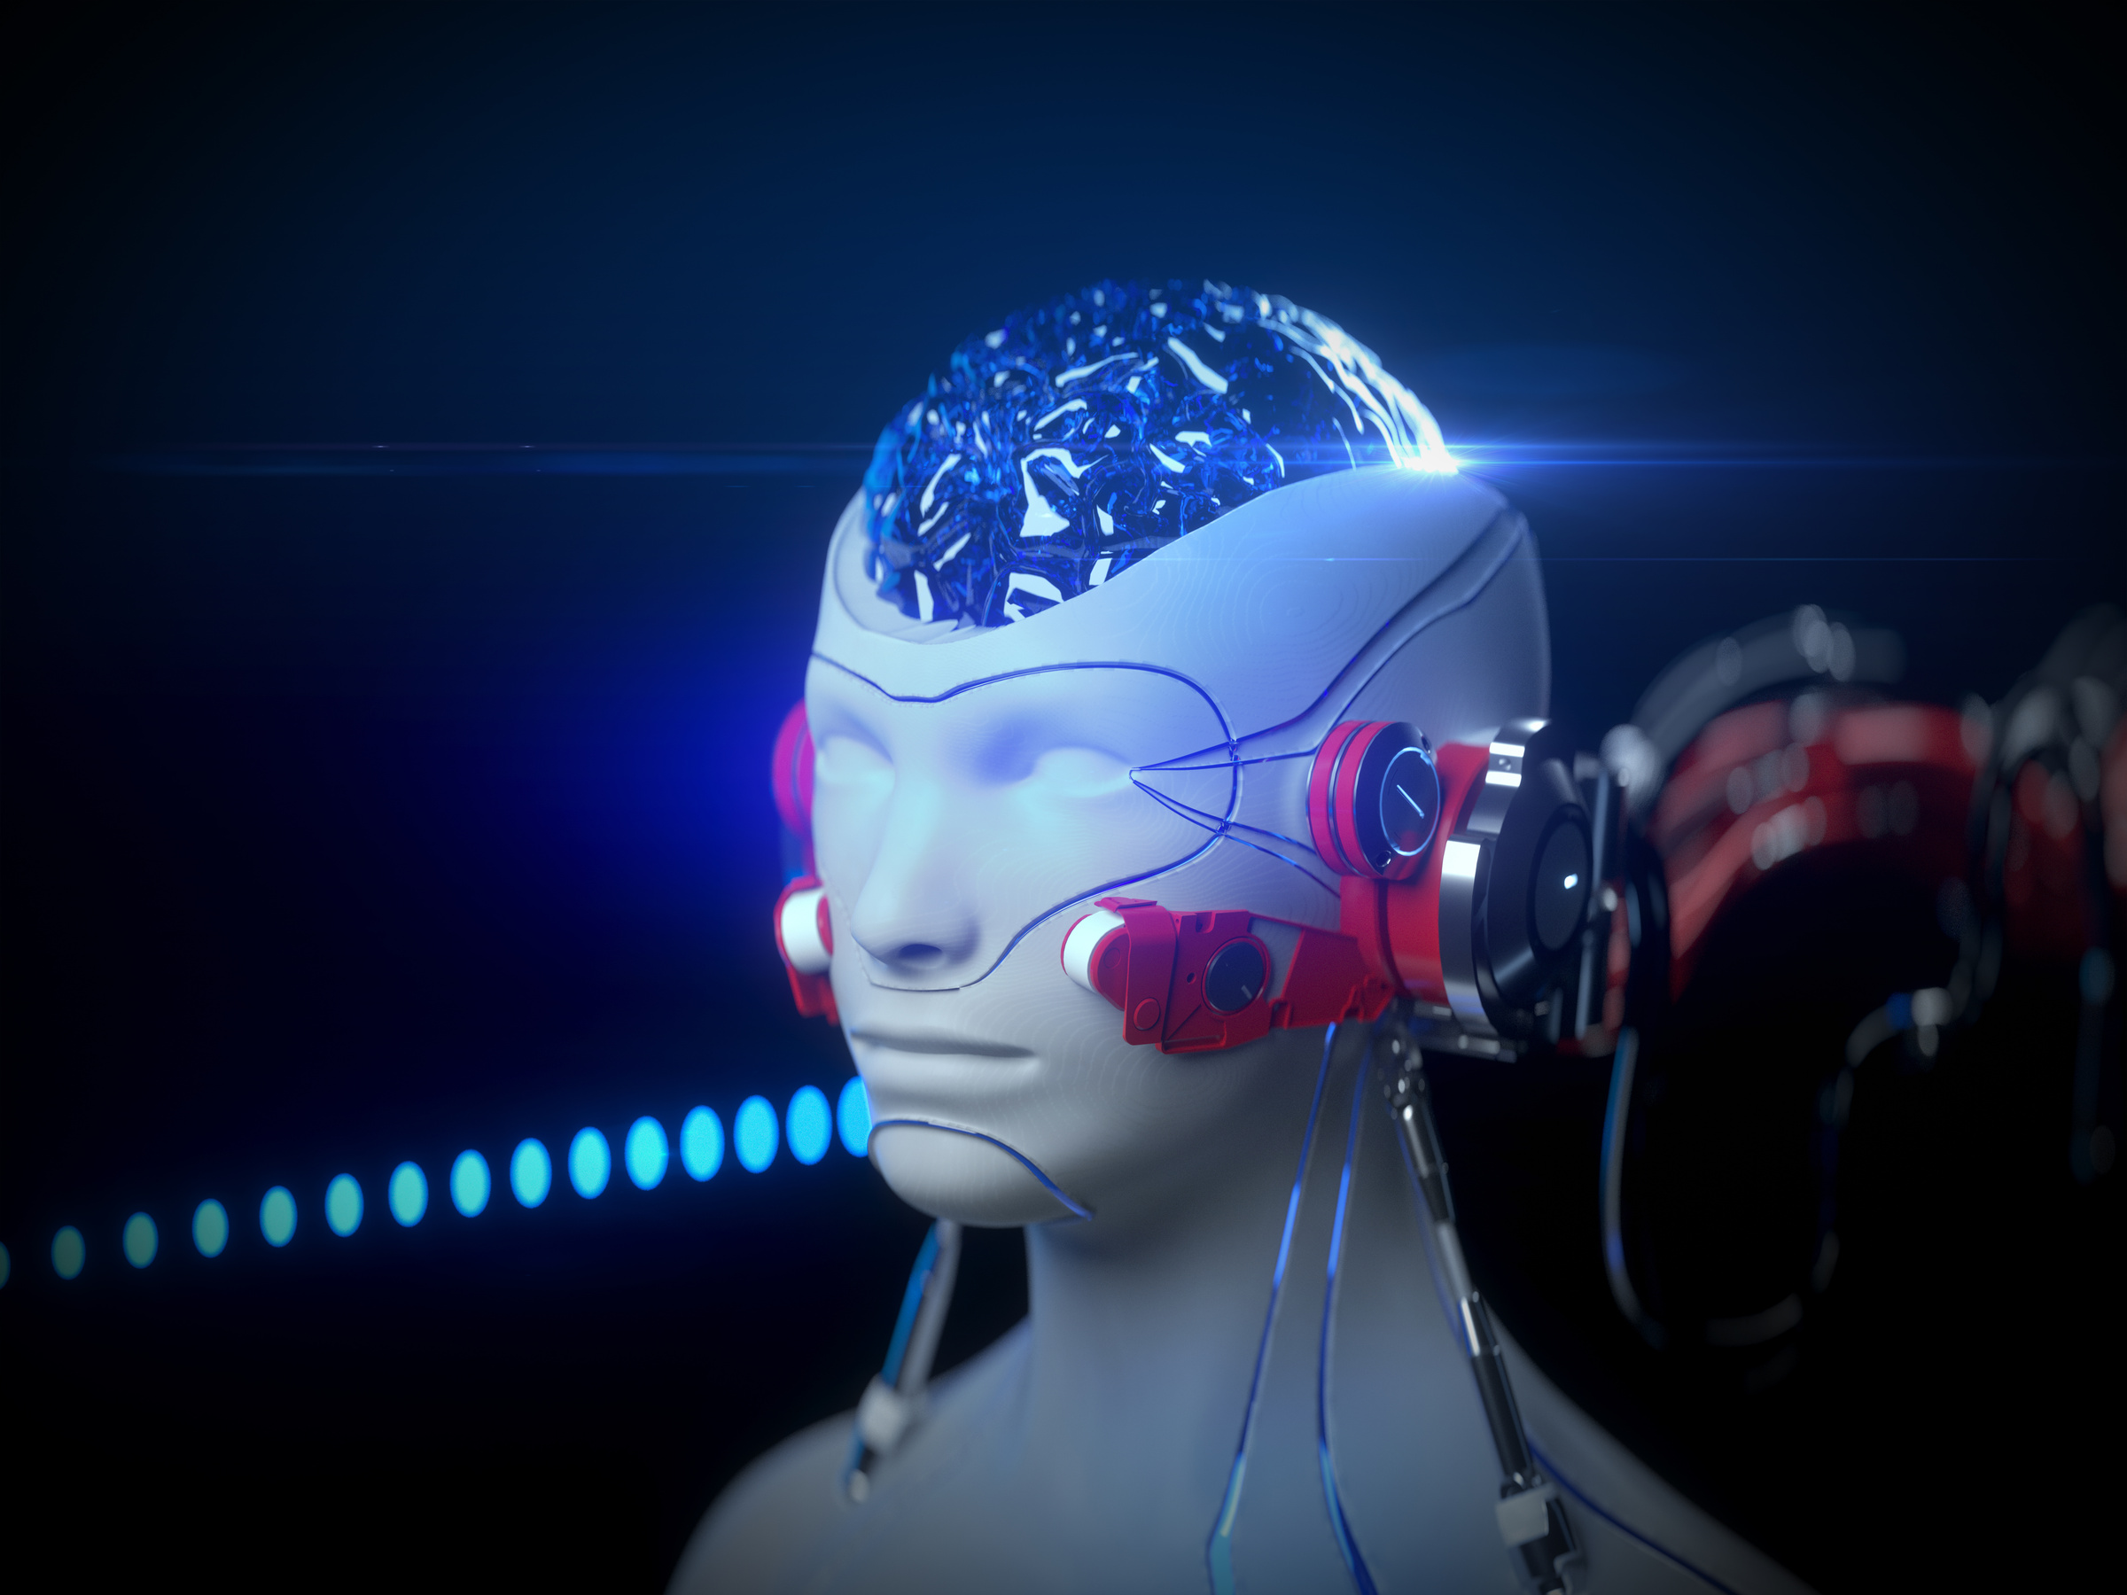
Larana, Inc.
Artificial Intelligence in Healthcare
By Dani Martinez
GET STARTED

Slide 2
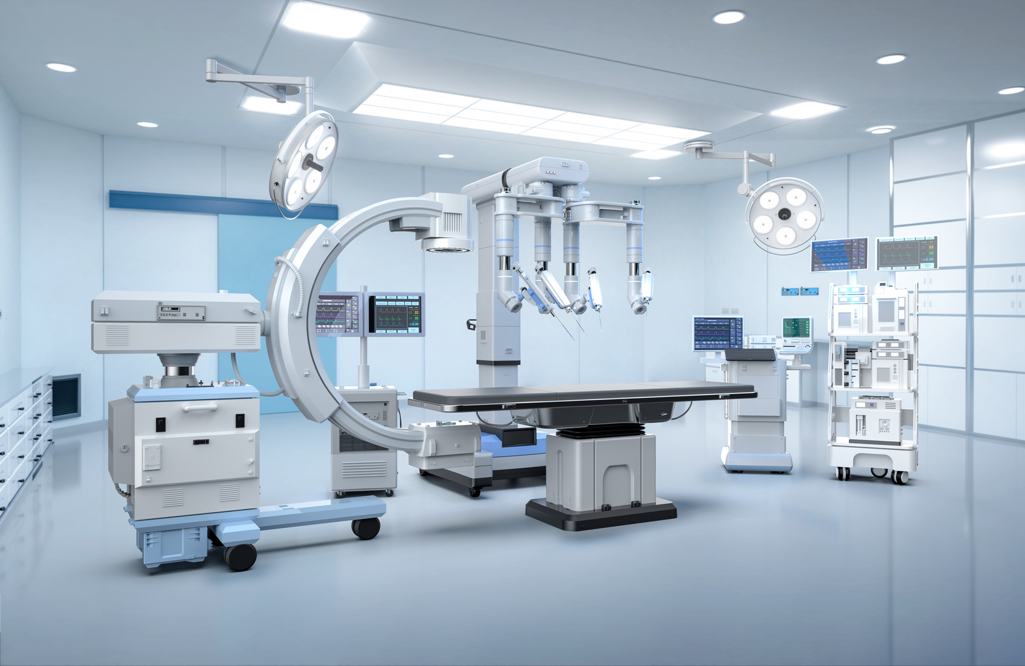
Introduction
Artificial Intelligence (AI) is rapidly transforming the healthcare sector, providing tools that enhance the precision and efficiency of medical services. From diagnosing diseases more accurately to improving patient outcomes, AI is reshaping how healthcare professionals approach medical challenges. Its ability to process vast amounts of data quickly allows for better decision-making and early detection of health conditions.
In this presentation, we will delve into how AI is impacting key areas such as medical diagnosis, personalized treatment, patient care, and hospital operations. The integration of AI not only enhances the quality of care but also opens new possibilities for future innovations in the healthcare industry.

Slide 3


The Role of AI in Medical Diagnosis
Artificial Intelligence is significantly enhancing the accuracy and speed of medical diagnoses. AI systems can analyze medical data such as imaging scans, lab results, and patient history to detect patterns that may not be easily recognizable by humans. This leads to more precise and timely diagnoses, especially in fields like radiology and pathology.
Additionally, AI has the potential to revolutionize early disease detection. By analyzing vast datasets and identifying subtle indicators, AI can assist in predicting conditions such as cancer or heart disease at earlier stages, giving patients a better chance of successful treatment and recovery.

Slide 4

AI in Personalized Medicine
Artificial Intelligence is enabling a shift towards personalized medicine, where treatment plans are tailored to the individual needs of each patient. By analyzing genetic information, lifestyle factors, and medical history, AI can recommend customized treatments that are more effective and better suited to each person’s unique profile.
Tailored Treatment Plans
Predictive Analytics
Improved Effectiveness
AI enables the development of customized treatment plans based on individual patient data, including genetic information and lifestyle factors.
By utilizing predictive analytics, AI helps healthcare providers anticipate patient outcomes, allowing for timely and proactive interventions.
Personalized approaches enhance treatment effectiveness while minimizing potential side effects, leading to better patient experiences and outcomes.

Slide 5


AI in Healthcare Procedures
Artificial Intelligence is making significant advancements in the field of surgery, contributing to improved precision and patient outcomes. AI-powered robotic systems assist surgeons in performing complex procedures with greater accuracy. These technologies help reduce invasiveness, which can lead to shorter recovery times and fewer complications.
Robotic-Assisted Procedures
AI enables the use of robotic systems that provide enhanced control and precision during various healthcare interventions. This technology allows for minimally invasive techniques, which can reduce physical impact on patients.
Enhanced Precision
With AI's ability to analyze real-time data, procedures can be performed with greater accuracy. This precision helps ensure that critical areas are preserved during interventions, leading to better outcomes.

Slide 6


AI in Medical Imaging
Artificial Intelligence is transforming the field of medical imaging by improving the efficiency and accuracy of image evaluation. With the ability to quickly analyze various types of medical images, AI assists healthcare professionals in identifying potential health issues more effectively. This technology streamlines the imaging process, allowing for quicker assessments.
Improved Detection
Minimized Errors
Faster Analysis

Slide 7



AI in Treatment Development
Artificial Intelligence is revolutionizing the process of developing new treatments, significantly accelerating the introduction of innovative therapies. By leveraging advanced algorithms and large datasets, AI can identify potential treatment candidates more efficiently than traditional methods. This innovative approach reduces the time and cost associated with bringing new therapies to patients.

Slide 8


AI in Patient Care and Monitoring
Artificial Intelligence is playing a crucial role in enhancing patient care and monitoring, enabling more personalized and proactive healthcare solutions. AI-driven tools and applications allow healthcare providers to monitor patient conditions in real-time, leading to better health outcomes and improved quality of care.
Improved Detection
AI Chatbots for Patient Support
Real-Time Health Analytics
Remote Monitoring

Slide 9
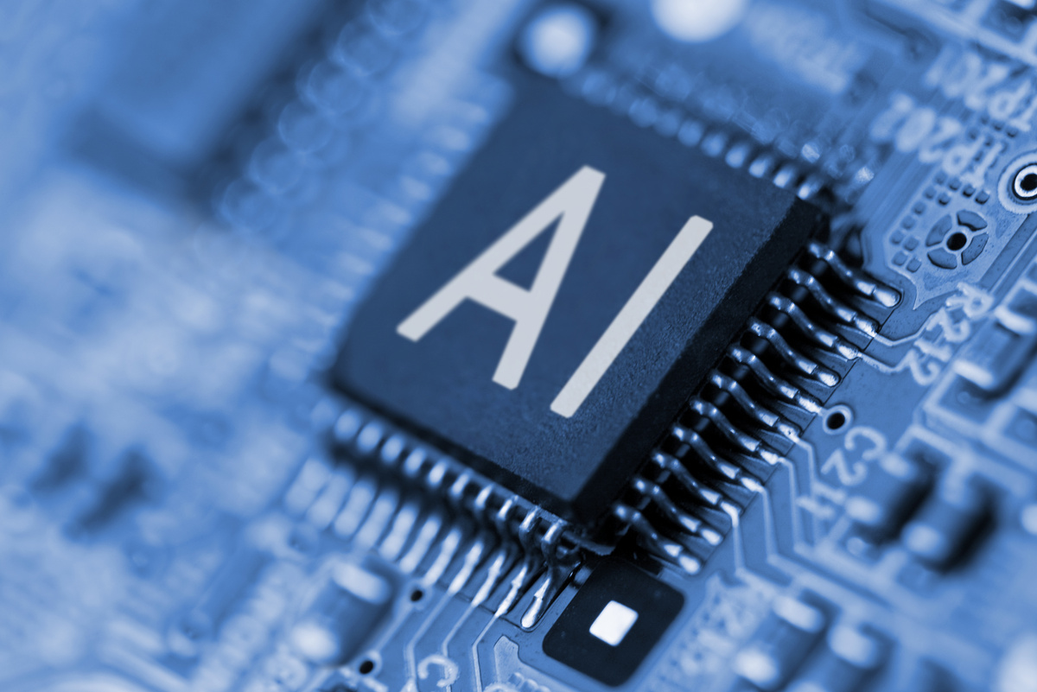

AI in Healthcare Administration
Artificial Intelligence is streamlining healthcare administration by automating routine tasks and improving efficiency. AI tools help manage data, reduce administrative burdens, and optimize workflows, allowing healthcare professionals to focus more on patient care.
Improving Data Management
Automating Administrative Tasks
Optimizing Workflows

Slide 10


AI in Patient Engagement
Artificial Intelligence is significantly enhancing patient engagement by providing tools that foster communication and interaction between healthcare providers and patients. These innovations help create a more personalized healthcare experience, improving patient satisfaction and adherence to treatment plans.
Compliance Monitoring
Incident Response Automation
AI tools help organizations maintain compliance with healthcare regulations by monitoring data handling practices. This ensures that institutions adhere to privacy standards and reduce the risk of violations.
In the event of a security incident, AI can automate responses to mitigate damage. This includes isolating affected systems and alerting IT personnel, thereby minimizing downtime and protecting patient information.

Slide 11

AI in Healthcare Data Security
Threat Detection
Data Encryption
AI systems can analyze patterns in data access and usage to identify unusual activity that may indicate a security breach. This proactive approach helps organizations respond swiftly to potential threats.
AI can assist in implementing advanced encryption techniques to protect sensitive information during transmission and storage, ensuring that patient data remains confidential.
Compliance Monitoring
Incident Response Automation
AI tools help organizations maintain compliance with healthcare regulations by monitoring data handling practices. This ensures that institutions adhere to privacy standards and reduce the risk of violations.
In the event of a security incident, AI can automate responses to mitigate damage. This includes isolating affected systems and alerting IT personnel, thereby minimizing downtime and protecting patient information.

Slide 12

AI in Training and Development
Artificial Intelligence is reshaping training and development within the healthcare sector by providing innovative tools and resources that enhance learning experiences for healthcare professionals. This technology facilitates ongoing education and skills development, ensuring that staff are equipped with the latest knowledge and techniques.
Simulated Training Environments
AI-powered simulations create realistic training scenarios for healthcare professionals, allowing them to practice skills and decision-making in a safe environment without risking patient safety.
Personalized Learning Paths
AI can assess individual learning needs and create tailored training programs that match each professional’s skill level and career goals, promoting more effective learning outcomes.

Slide 13

Challenges and Considerations of AI in Healthcare
While Artificial Intelligence offers numerous benefits to the healthcare sector, it also presents several challenges and considerations that must be addressed to ensure its successful implementation. Understanding these issues is essential for optimizing AI's impact on patient care.
Data Privacy and Security
Regulatory Compliance
Protecting sensitive patient information is paramount. Healthcare organizations must implement robust data security measures to prevent breaches and ensure compliance with regulations.
Navigating the regulatory landscape can be challenging for AI applications in healthcare. Organizations must ensure that AI tools comply with relevant guidelines to maintain patient safety and trust.

Slide 14

Future Trends in AI in Healthcare
As Artificial Intelligence continues to evolve, several trends are emerging that are likely to shape the future of healthcare. These advancements promise to enhance patient care and streamline healthcare delivery further.
Increased Personalization
Enhanced Predictive Analytics
ntegration of AI with Telehealth

Slide 15






Larana, Inc.
Thank You
For your attention! If you have any questions or would like to discuss further, please feel free to reach out.
www.reallygreatsite.com
hello@reallygreatsite.com
123-456-7890
123 Anywhere St., Any City

